Slide 1

TRAIN RESERVATION SYSTEM

Slide 2


Presented by: Batch-90
Gayatri Jaiswal (Emp Id: 6242) Gaganashree Ram (Emp id: 6237) Prem Ganesh (Emp id: 6240) Gumit Rathore (Emp id: 6248) Harsh Nayak (Emp id: 6238)
Donavalli Nani Babu (Emp id: 6250)

Slide 3
CONTENTS
Introduction
Problem Statement
System design
Technology
Screenshots
Future Enhancement

Slide 4
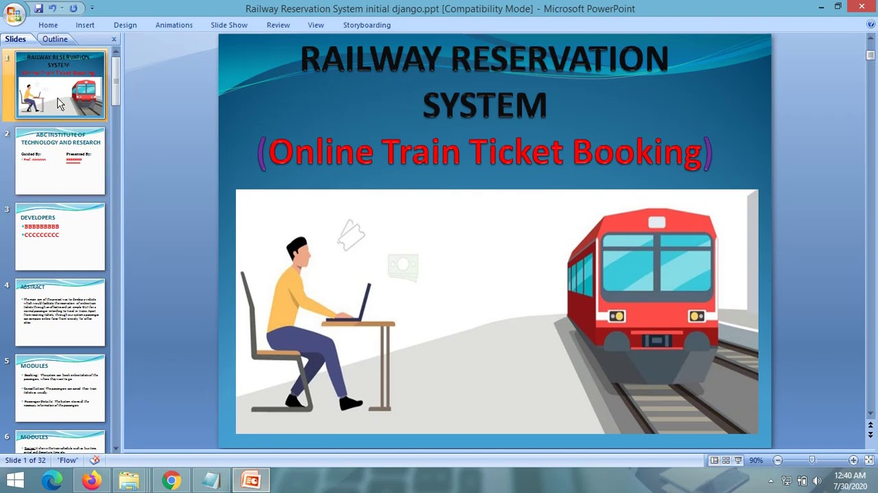
INTRODUCTION
The project "Train Reservation System" deals with the automation of the reservation and enquiry of the railway reservation system.
It maintains all information starting from reservation to cancellation of tickets. It also acts as an enquiry system about the different trains available. It gives the details of the available trains and it generates a ticket after successful reservation.
The Computerization is aimed at job simplification and reducing the manual work and effective record maintenance.

Slide 5
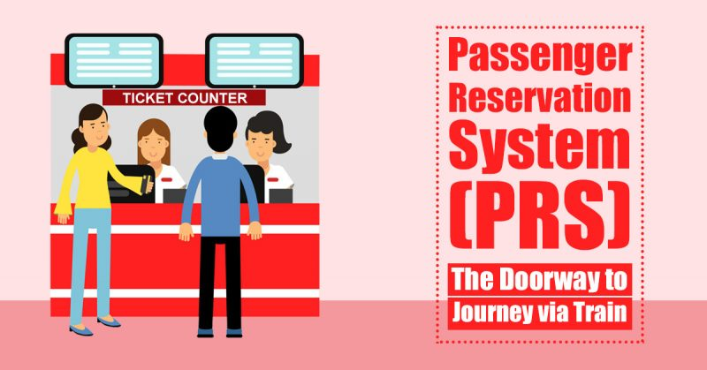
PROBLEM STATEMENT
Customer information centers at the railway stations are unable to serve such queries at peak periods
The number of the reservation counters available to the passengers and customers are very less
On most of the reservation systems there are long queues, so it takes a long time for any individual to book the ticket

Slide 6
SYSTEM DESIGN
Browser
Controller layer
Service layer
Repository/ DOA layer
Database
View
Home
User login
Admin
Admin
Login
Train details
Add Train
User
Add passenger
Train details
Valid user
Yes
Book ticket
Payment
No
Print
Register
Sign out

Slide 7


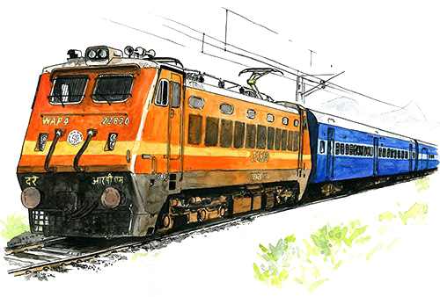




TECHNOLOGIES
Spring Boot
MySQL
HTML5
CSS3
Bootstrap
JavaScript

Slide 8
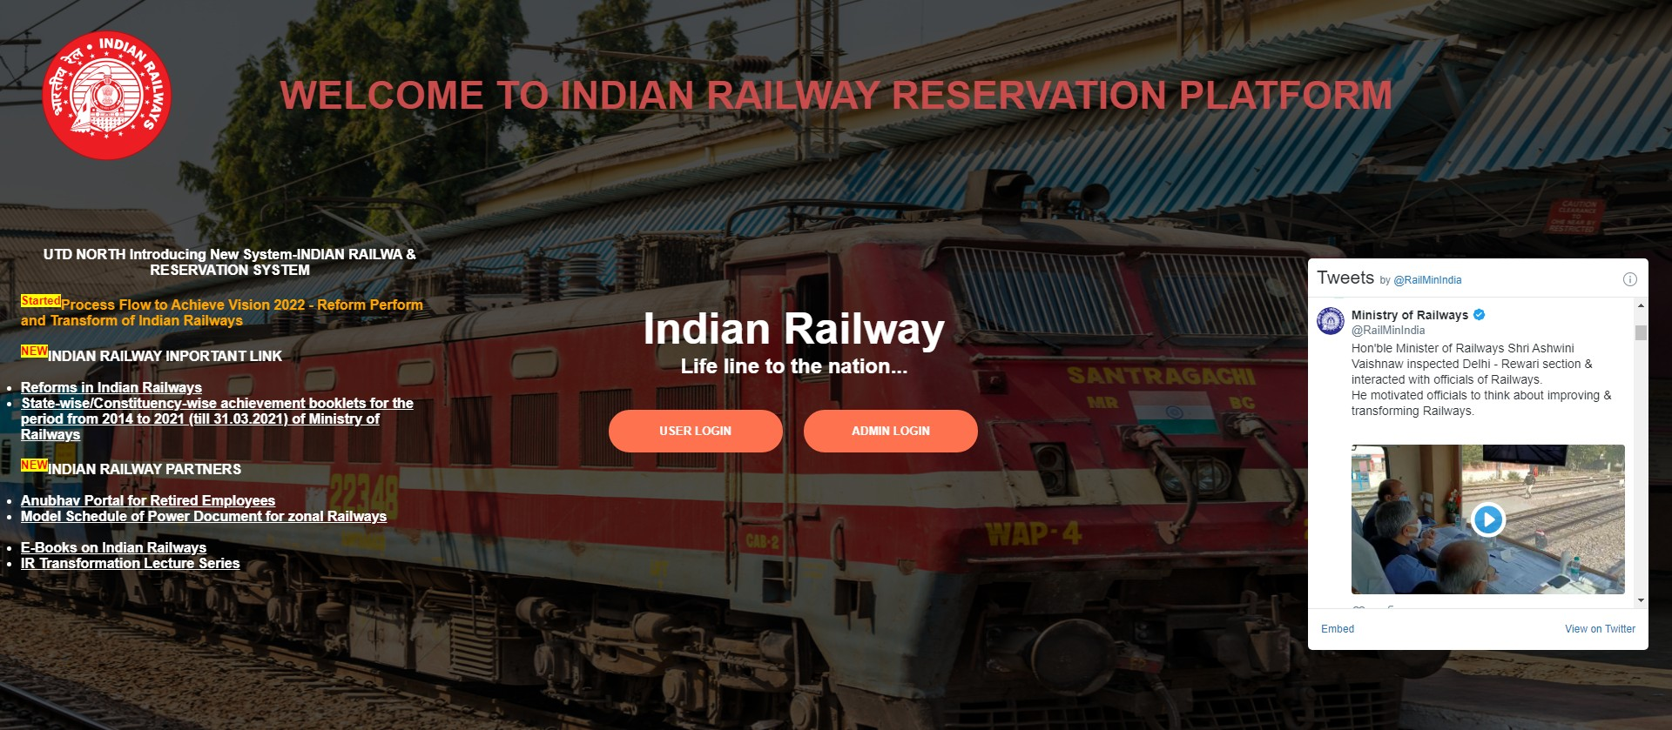
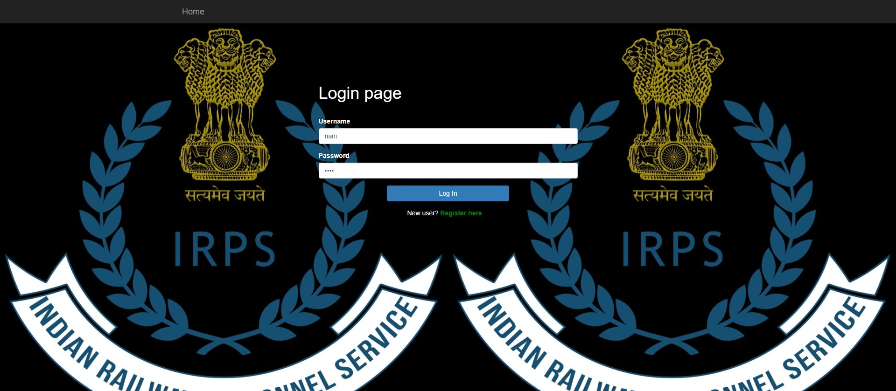
Screenshots
Admin

Slide 9
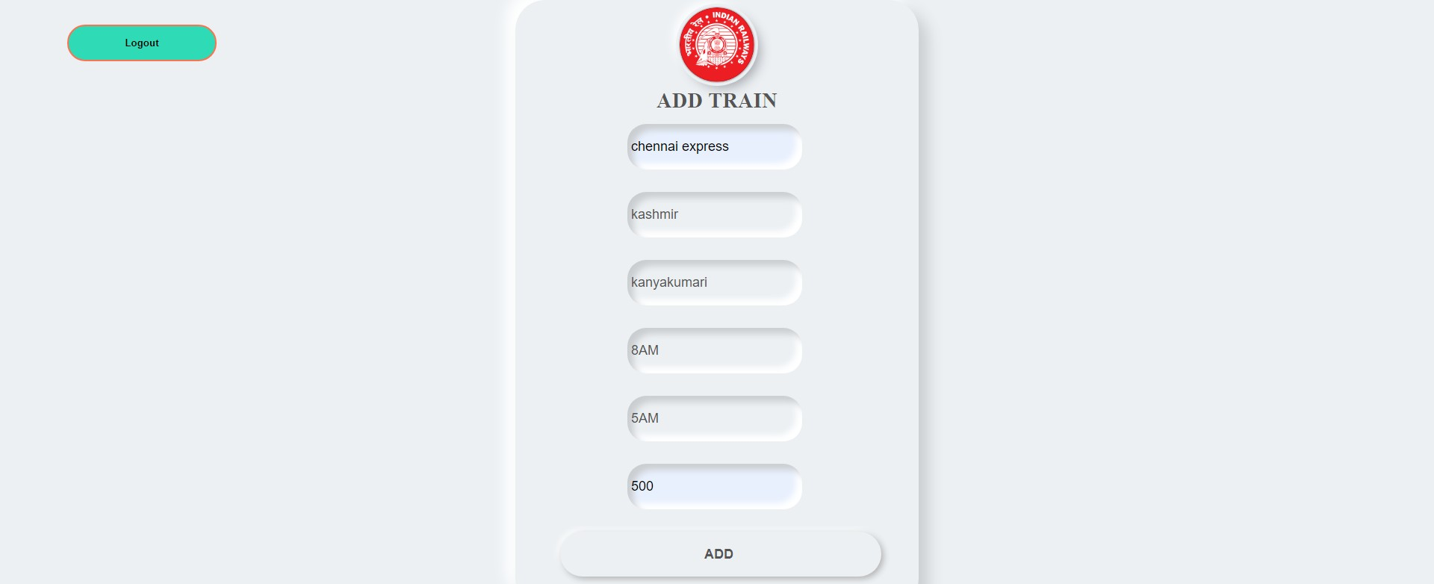
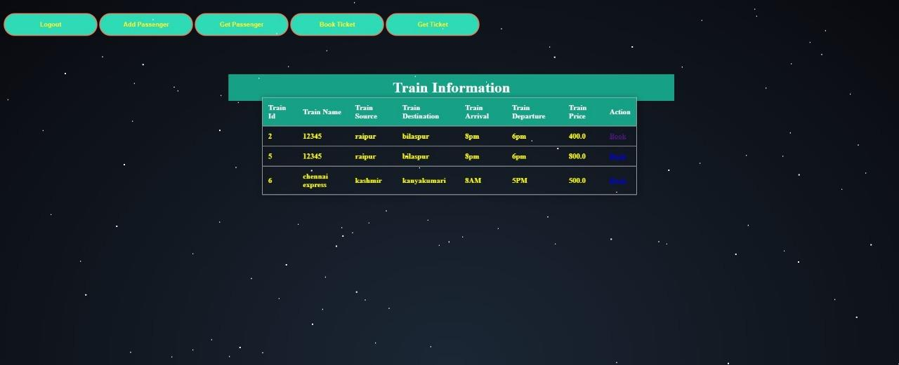

Slide 10
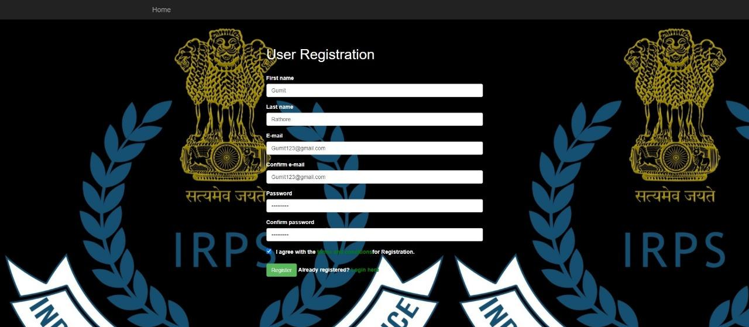
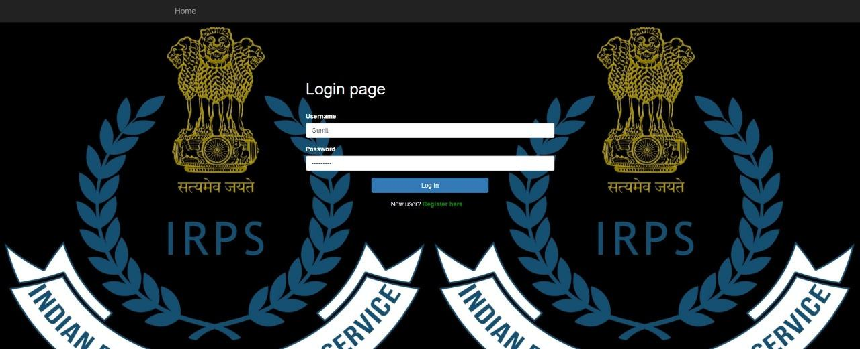
Admin- Edit Train
User Login / Registration

Slide 11

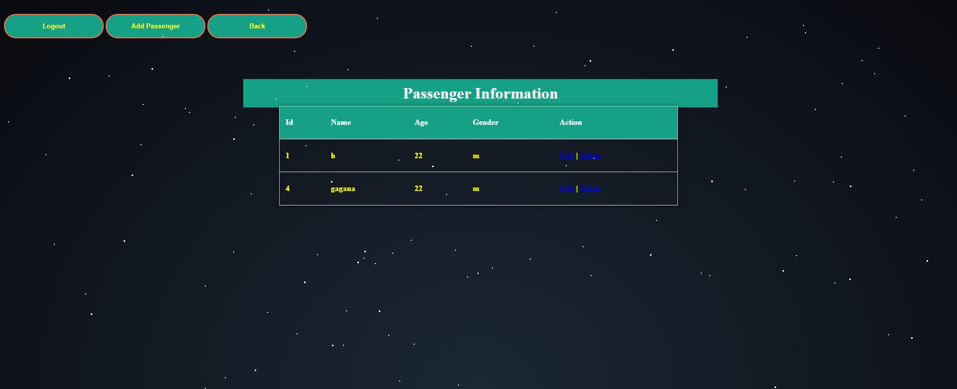
User Perspective
Add Passenger

Slide 12
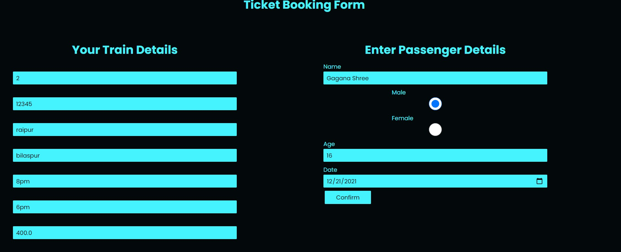
User Perspective-TICKET
Ticket Booking

Slide 13
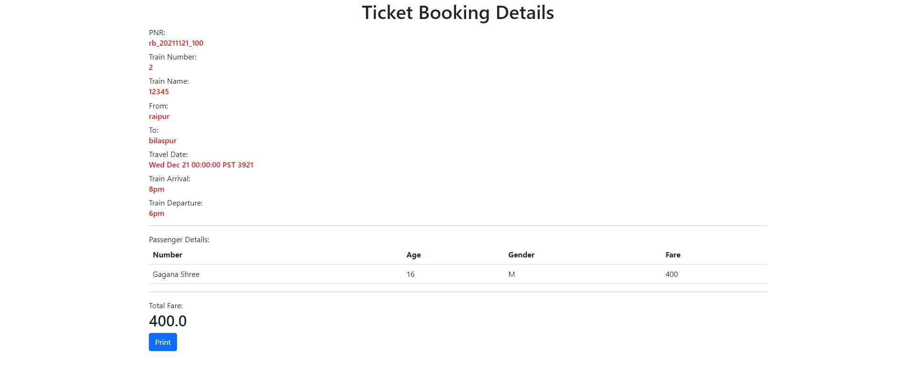
Ticket Details

Slide 14
FUTURE ENHANCEMENT
The Advanced software of Railway Reservation System can be provided including more facilities and making users to book tickets easily.
A database can be added to the check availability of seats which are available after the cancellation of ticket on that specific train.
The platform and routes can be host on online service to make accessible to users by creating the accurate databases and security structure in railway reservation.
Project can be updated in near future as and when requirement for the same arises, as it is very flexible in terms of expansion.

Slide 15
THANK YOU

